Slide 1
Module 1: The MVC Pattern
SER 423

Slide 2
Designing Your Tech Stack

Slide 3
How to Organize Your Code
In previous courses you have probably spent some time on how to organize your code and the overall structure of the program
While some assignments may have had requirements for how to structure your program, it has usually been left up to you
With mobile apps, you can of course build them however you want
Remember those issues that were specific to mobile development
Therefore, there is one prevailing structure that is recommended and used by most apps out there right now
Android and iOS components use this pattern as well

Slide 4
The MVC Design Pattern
The preliminary structure used when developing mobile apps is the Model, View, Controller (MVC) model. This breaks your program down into three distinct layers.
View - The top most layer closest to the User
Controller - The middle layer that houses the main logic and communicates with the other two layers
Model - The bottom layer that holds the structured data furthest from the User

Slide 5
The Layers

Slide 6
The Model Layer
Again, this is the lowest layer
Farthest from the User
This is where we put all of our structured data
You might think of this as the data layer
Pictures, Saved Game Files, Hardcoded Strings, Preferences, etc.
Much of this data is static
This layer is made up of data and the rules for its representation

Slide 7
The View Layer
The closest layer to the User
This is what the User of the app sees
It is the presentation layer
Buttons, Lists, Images, etc.
This layer should be lightweight, only displaying objects and receiving User Actions

Slide 8
The Controller Layer
This is the middle layer that communicates with the other two layers
This will house the majority of the program logic
The Model layer will have rules for what to show at startup, and the controller will pass that information up to the View layer
User actions will come from the View layer, which then need to be processed and the View and/or Model will be updated by the Controller
The Model may notify the Controller if something has changed and the Controller will update the other two layers as needed again

Slide 9
The MVC as a Whole

Slide 10
Diagram of the MVC Interactions
Notifies
User Action
Model Layer
Controller Layer
View Layer
Updates
Updates

Slide 11
Why We Use This Structure
The Model never talks to the View or vice versa
This means all inter-layer communication goes through the Controller
Keeps the out two layers lighter
Minimizes chances of conflicts from threads or User Interruption
Makes threading easier
Similar to structures used in production level web servers

Slide 12
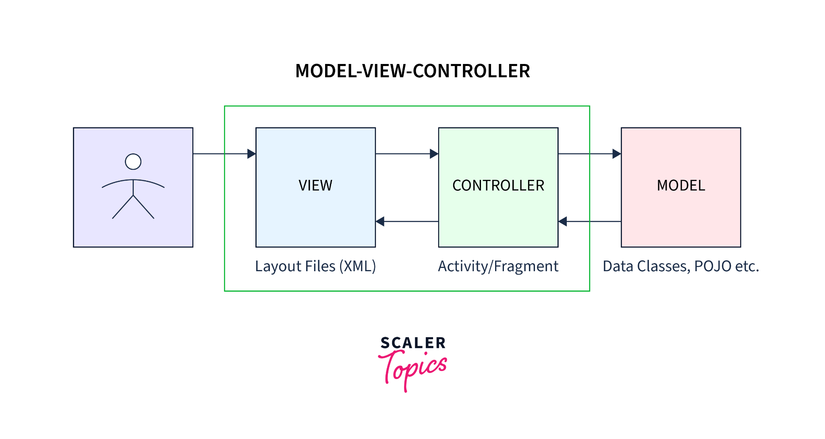
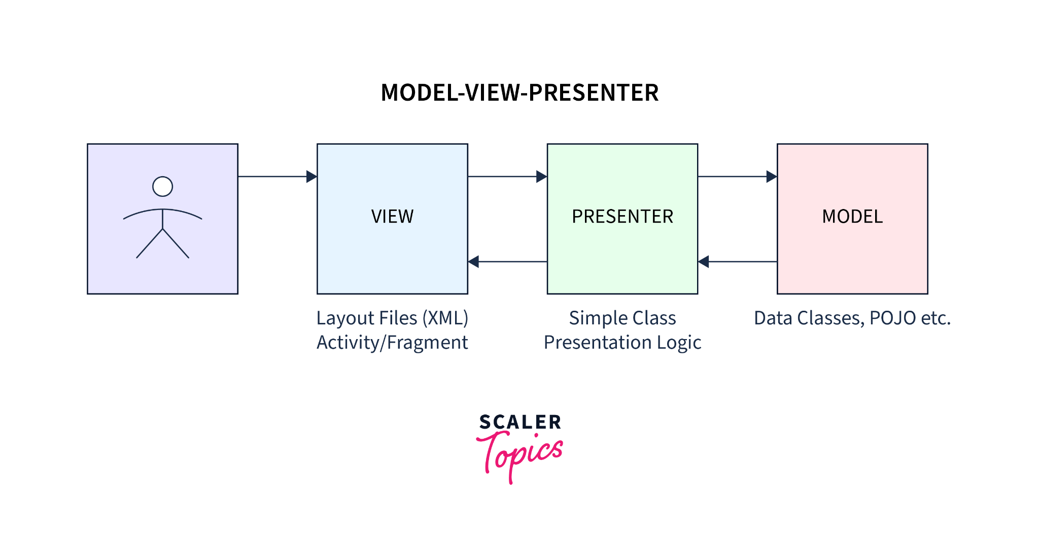
The Next Step - MVP

Slide 13
Key Differences
MVC | MVP
The View layer may have direct references to the Model and Controller layers. | The View layer has no direct references to the Model layer and only indirect references to the Presenter layer. The Presenter retrieves data from the Model layer, processes it, and updates the View accordingly. The View layer should not directly access the Model layer.
The Controller layer can make changes in the View layer. | The Presenter layer can only provide data to the View layer that would then be rendered by the View.
Due to the dependencies on the View layer, the Controller layer was difficult to test. | Due to the separation of concerns, the Presenter layer could be tested independently
There's a many-to-one relationship between the View and the Controller because a Controller is capable of managing different Views. | The View and the Presenter layer have a one-to-one relationship. The Presenter layer can manage a single View only.

Slide 14
End of The MVC Pattern
That is all for Module 1

